Slide 1
Convolutional neural network (CNN)

Slide 2
CNN
In deep learning, a convolutional neural network (CNN, or ConvNet) is a class of deep neural networks, most commonly applied to analyzing visual imagery.
The pre-processing required in a ConvNet is much lower as compared to other classification algorithms.
The architecture of a ConvNet is analogous to that of the connectivity pattern of Neurons in the Human Brain.
The role of the ConvNet is to reduce the images into a form which is easier to process, without losing features which are critical for getting a good prediction.

Slide 3


Slide 4
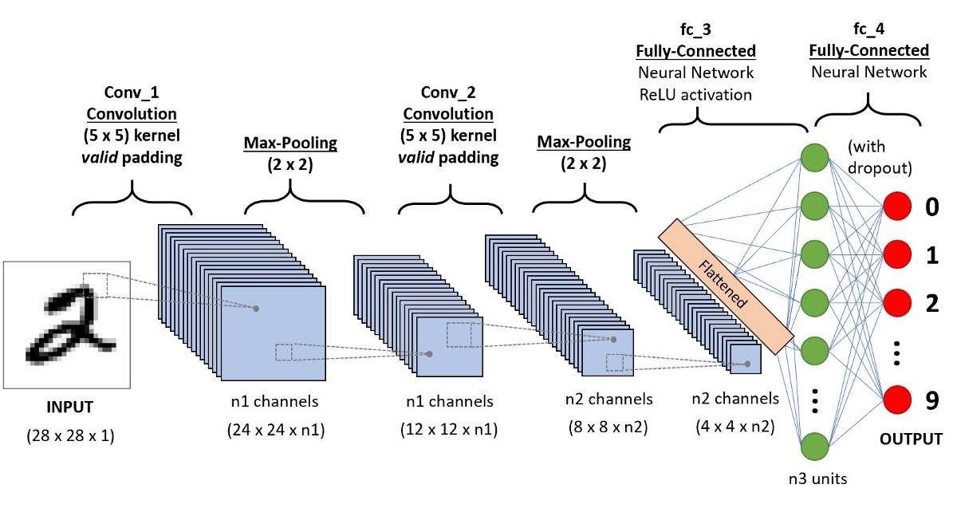

Slide 5
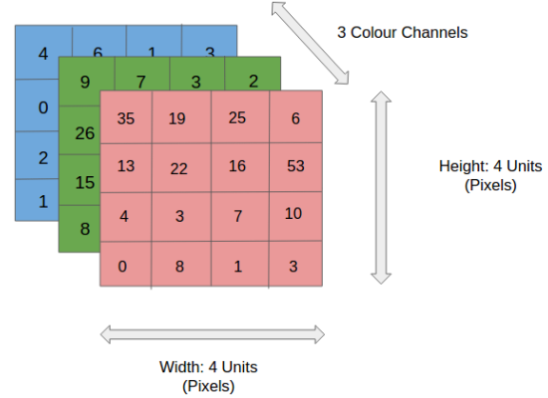

Slide 6
Convolution Layer — The Kernel Convoluting a 5x5x1 image with a 3x3x1 kernel to get a 3x3x1 convolved feature

